Slide 1
BONDING IN BIOLOGICAL SAMPLES
&
ROLE OF CARBON AND WATER IN LIVING ORGANISMS

Slide 2
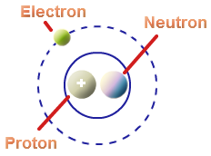
CHEMISTRY OF LIFE
All matter is composed of simple units called atoms
Atom consists of a charged nucleus made of protons and neutrons surrounded by electrons
Same kind of atoms combine to form elements
Six elements that occur in nature are: Carbon, Hydrogen, Nitrogen, Oxygen, Phosphorous and Sulphur
Two or more elements combine to form compound.

Slide 3
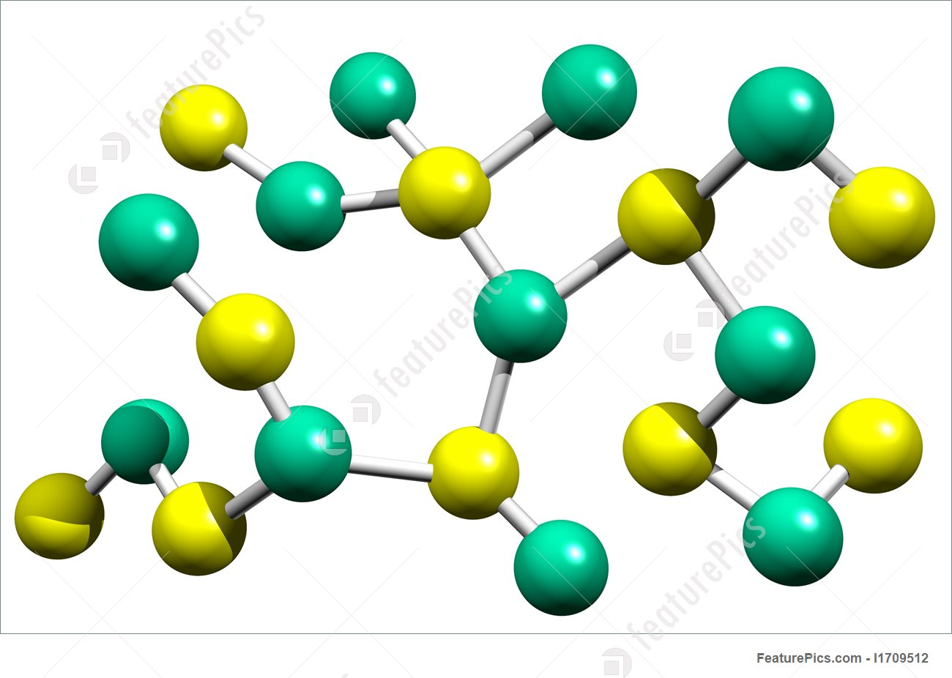
TYPES OF CHEMICAL BONDING
Atoms tend to arrange themselves in the most stable patterns possible (octet configuration or doublet configuration), which means that they have a tendency to complete or fill their outermost electron orbits.
In order to achieve stability, they join with other atoms
The force that holds atoms together is referred to as a chemical bond.
The different types of bonds are
Covalent Bonds
Non-Covalent bonds
Ionic bonds
Hydrogen bonds
Hydrophobic interactions
van der Waals attraction

Slide 4
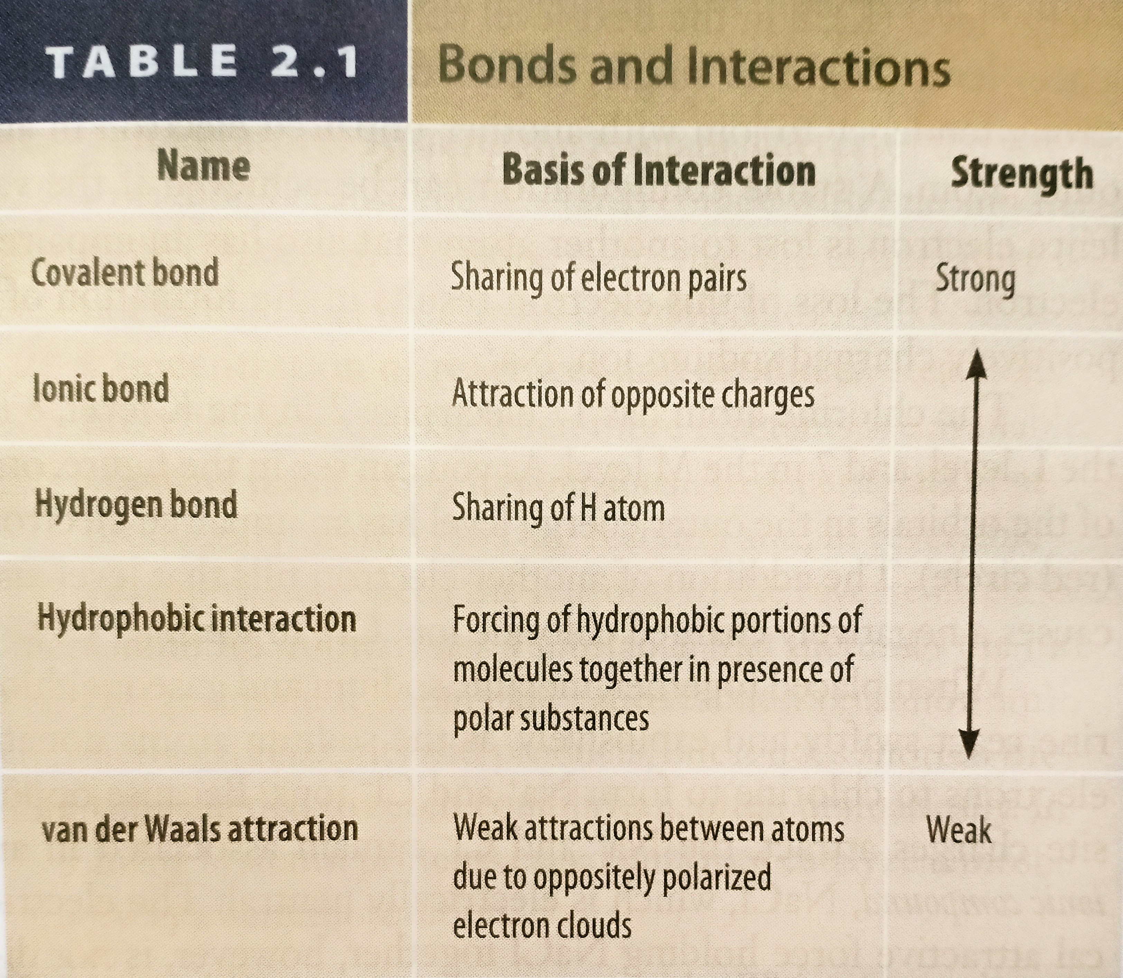

Slide 5
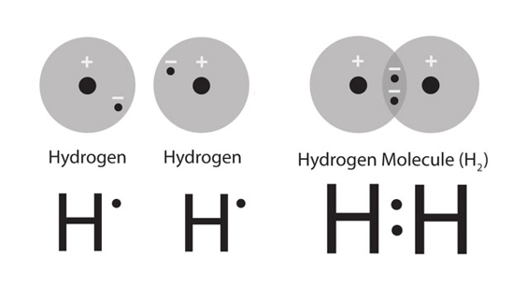
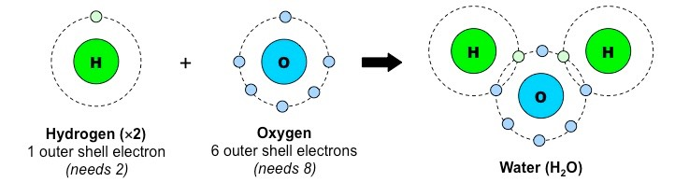
COVALENT BONDS
Covalent bonding occurs between two non-metals
Because both atoms have a large number of electrons in their outer shell, it is not feasible to lose or gain so many and so they share.
The number of covalent bonds able to be formed reflects the number of missing electrons from the outer shell (e.g. carbon needs four electrons and so can form four covalent bonds)
Covalent bonds are of two types - polar and nonpolar covalent bonds.
Polar covalent bonds occurs in between atoms with different electronegativities while nonpolar occurs between atoms with same electronegativities.
Notes:
The covalent sharing of electrons between atoms may not always be equal and will depend on:
The number of protons in an atom (more protons equals a greater attraction for electrons)
The number of electron shells in an atom (electrons at a further distance from the nucleus are less attracted to nucleus)
Atoms that have a stronger affinity for electrons are said to have a higher electronegativity
Covalently shared electrons will orbit closer to atoms with a higher electronegativity, resulting in a slight charge difference

Slide 6
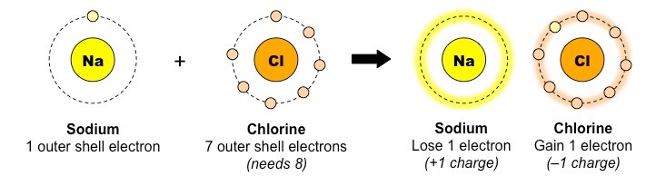
NON-COVALENT BONDS
Ionic bonding occurs between a metal and a non-metal
The metal has a nearly empty outer shell and so loses electrons to form a positively charged cation
The non-metal has a nearly full outer shell and so gains electrons to form a negatively charged anion
The resulting charge of these two ions creates a strong electrostatic attraction between them - an ionic bond
a) Ionic bonds

Slide 7
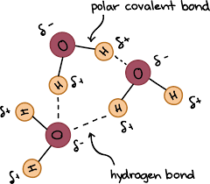
b) Hydrogen Bonds
Hydrogen bonds are the attractive forces between a H atom (attached to an electronegative atom) of one molecule and a highly electronegative atom (either F, O or N atom) of another molecule.
The H atom has a partial positive charge (δ⁺) and the electronegative atom (with which H will form hydrogen bond) has a partial negative charge (δ⁻).
Hydrogen bonding is responsible for
(i) unique properties of water
(ii) holding DNA together
(iii) protein folding

Slide 8
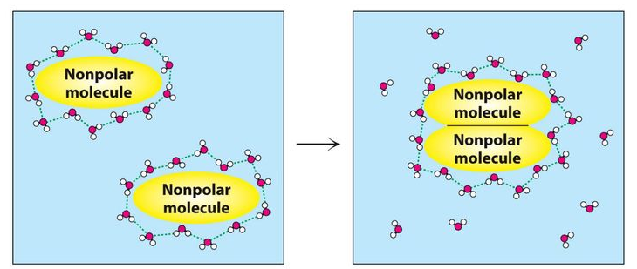
c) Hydrophobic interactions
Hydrophobic interactions describes the relation between water and non-polar molecules
Mixing of fat and water is a good example of this interaction
Fat molecules tend to clump up together rather than distributing itself in a water medium, because this allows the fat molecules to have minimal contact with water

Slide 9
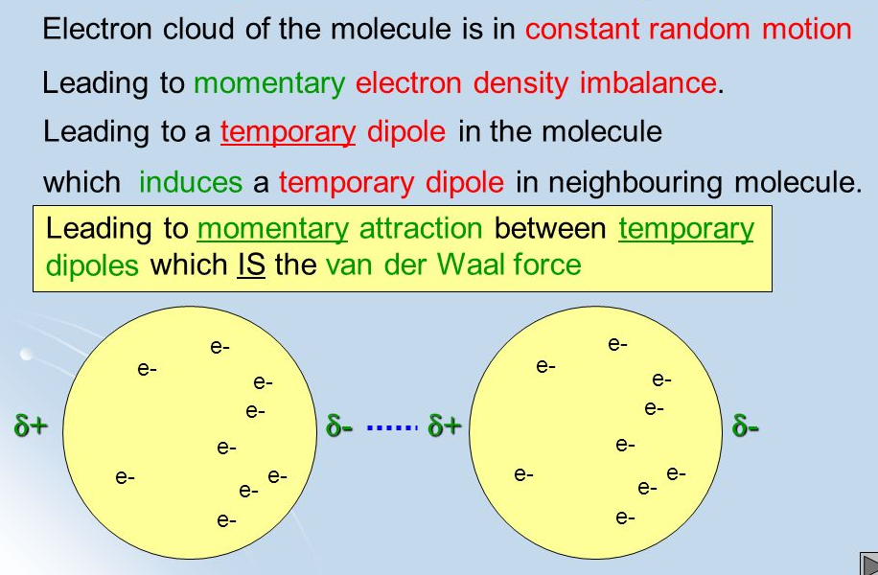
d) van der Waals attraction

Slide 10
CARBON
The wide range of biodiversity on Earth relies largely on four major building blocks: hydrogen, oxygen, carbon and nitrogen.
All living things contain carbon in some form.
Carbon is the primary component of macromolecules, including proteins, lipids, nucleic acids, and carbohydrates.
Carbon’s molecular structure allows it to bond in many different ways and with many different elements.
The carbon cycle shows how carbon moves through the living and non-living parts of the environment.

Slide 11
The Role of Carbon in Living Organism
1) Carbon is the basic building block for all forms of life on Earth as it is the primary component of macromolecules, including proteins, lipids, nucleic acids, and carbohydrates.
2) Carbon is the key for photosynthesis, which ultimately provides food for all living things on Earth and respiration which results in production of energy. Respiration also maintains a steady supply of carbon atoms that are necessary for building any animal cells.
3) Carbon in the organic waste matter and dead organisms is the food source for decomposers (tiny microorganisms that live in soil and water) that return carbon back into the atmosphere in the form of carbon dioxide.

Slide 12
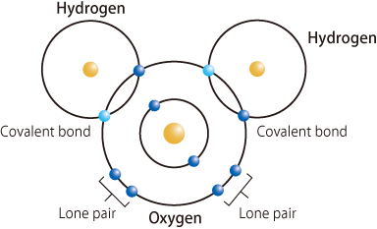
STRUCTURE OF WATER MOLECULE
Water is a molecular compound, with molecular formula H₂O. The atoms in a water molecule are held together by strong covalent bonds. These are very difficult to break.
The dot-and-cross diagram for a water molecule shows there are two bonding pairs of electrons and two non-bonding pairs of electrons.
The four pairs repel one another, forming a tetrahedral pattern.
The two electrons in each oxygen-hydrogen bond are not shared equally. They are more strongly attracted to the oxygen atom.
A hydrogen bond forms between a non-bonding pair of electrons on the oxygen atom of one water molecule and the hydrogen atom ('positive end') of another water molecule.

Slide 13
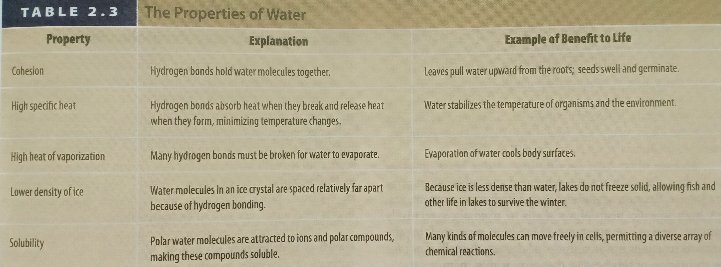
The Role of Water in Living Organism

Slide 14
The Role of Water in Living Organism
1) Water acts as a universal solvent for numerous biochemical molecules and helps in transport of dissolved compounds in and out of cells. (i.e., helps in transport of nutrients, e.g. glucose and amino acids in blood, and sucrose in phloem, removal of excretory products, e.g. ammonia, urea and secretion of substances, e.g. hormones, digestive juices).
2) Water acts as a metabolite i.e., it is a raw material or a product of many metabolic reactions like photosynthesis, digestion and aerobic respiration.
3) Water is not easily compressed and has an important role in support in plants and animal (uptake of water by plant cells creates a pressure against the rigid cell wall. This turgor pressure helps non-woody plants to remain upright, water provides buoyancy for aquatic organisms, e.g whales).

Slide 15
4) Water plays a role in the stabilization of structure of nucleic acids and proteins
5) Water has a high specific tension and this property allows aquatic insects to walk on the surface of water.
6) Water molecules have cohesive forces holding them together, due to hydrogen bonding between water molecules which allows water to be pulled through xylem in plants.
7) Water has a high specific heat capacity and so plays an important role in temperature regulation (e.g. Reduce temperature fluctuations in organisms - especially large ones, minimize increases in temperature in cells as a result of biochemical reactions, reduce fluctuations in temperature in aquatic habitats)
8) Water has a high latent heat of vaporization. This helps some animals to maintain a constant body temperature as a high amount of heat energy is removed from the body to evaporate sweat.
9) Water serves as a living environment for a variety of aquatic organisms.

Slide 16
QUESTIONS
List the important functions of water in living organisms
List the important functions of carbon in living organisms
Describe the different types of bond found in living organisms

